Slide 1
PQTrees
Representing Gene Clusters with Gene Duplications
Lev Gourevitch
Advisors – Prof. Michal Ziv-Ukelson, Galia Zimerman

Slide 2
Citations
The work in this project is based on previous work as described in:
Gene Proximity Analysis Across Whole Genomes via PQ Trees ﻿Gad M. Landau, Laxmi Parida, and Oren Weimann
﻿Fast Algorithms to Enumerate All Common Intervals of Two Permutations ﻿Takeaki Uno and Mutsunori Yagiura

Slide 3
The Problem – Similar “String” Discovery
We would like to discover similar strings To an initial family of strings, while keeping the representation compact, and the concept of similarity conservative
Strings – Strings could be a sequence of genes, a sequence of amino acids, etc.

Slide 4
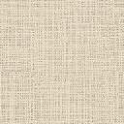




M J K J I H G F C D E
initial family
M J K J I H G C D E F
C D E M J K J I H G F
RNDR
R
Tree Representation
Transport
Metabolism
M
J
K
J
I
H
G
F
C
D
E
Similar ”String”
F E D C M J K J I H G

Slide 5
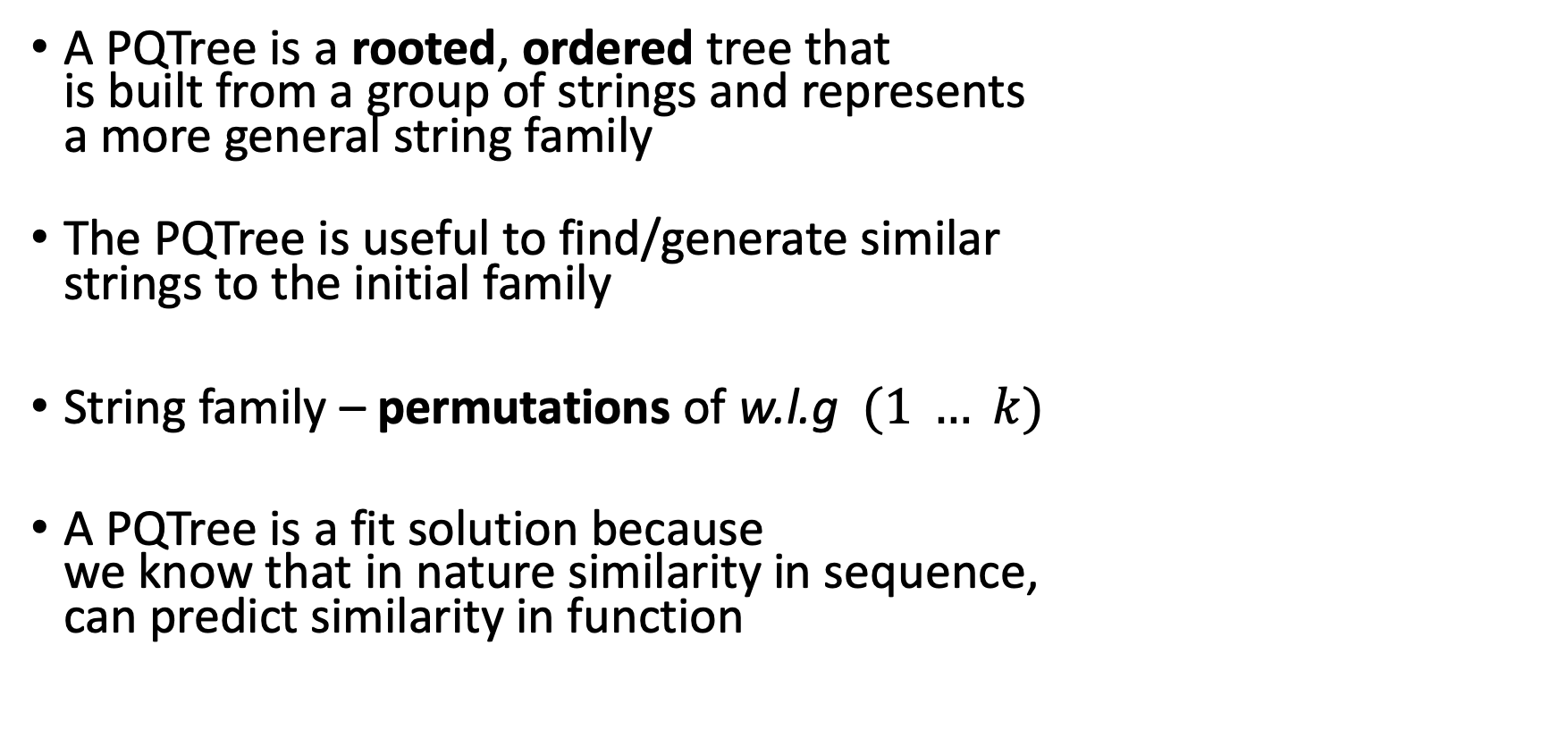
Proposed solution - PQTree
A PQTree is a rooted, ordered tree that is built from a group of strings and represents a more general string family
The PQTree is useful to find/generate similar strings to the initial family
String family – permutations of w.l.g $(1 … k)$
A PQTree is a fit solution because we know that in nature similarity in sequence, can predict similarity in function

Slide 6
PQTree – Representation
Node Yield – strings representable by a node
A PQTree represents the yield of its root
Invariant – the family of strings that was used to build the tree is a subset of it’s Yield
A PQTree consist of P nodes and Q nodes – each yields its children in a different manner

Slide 7
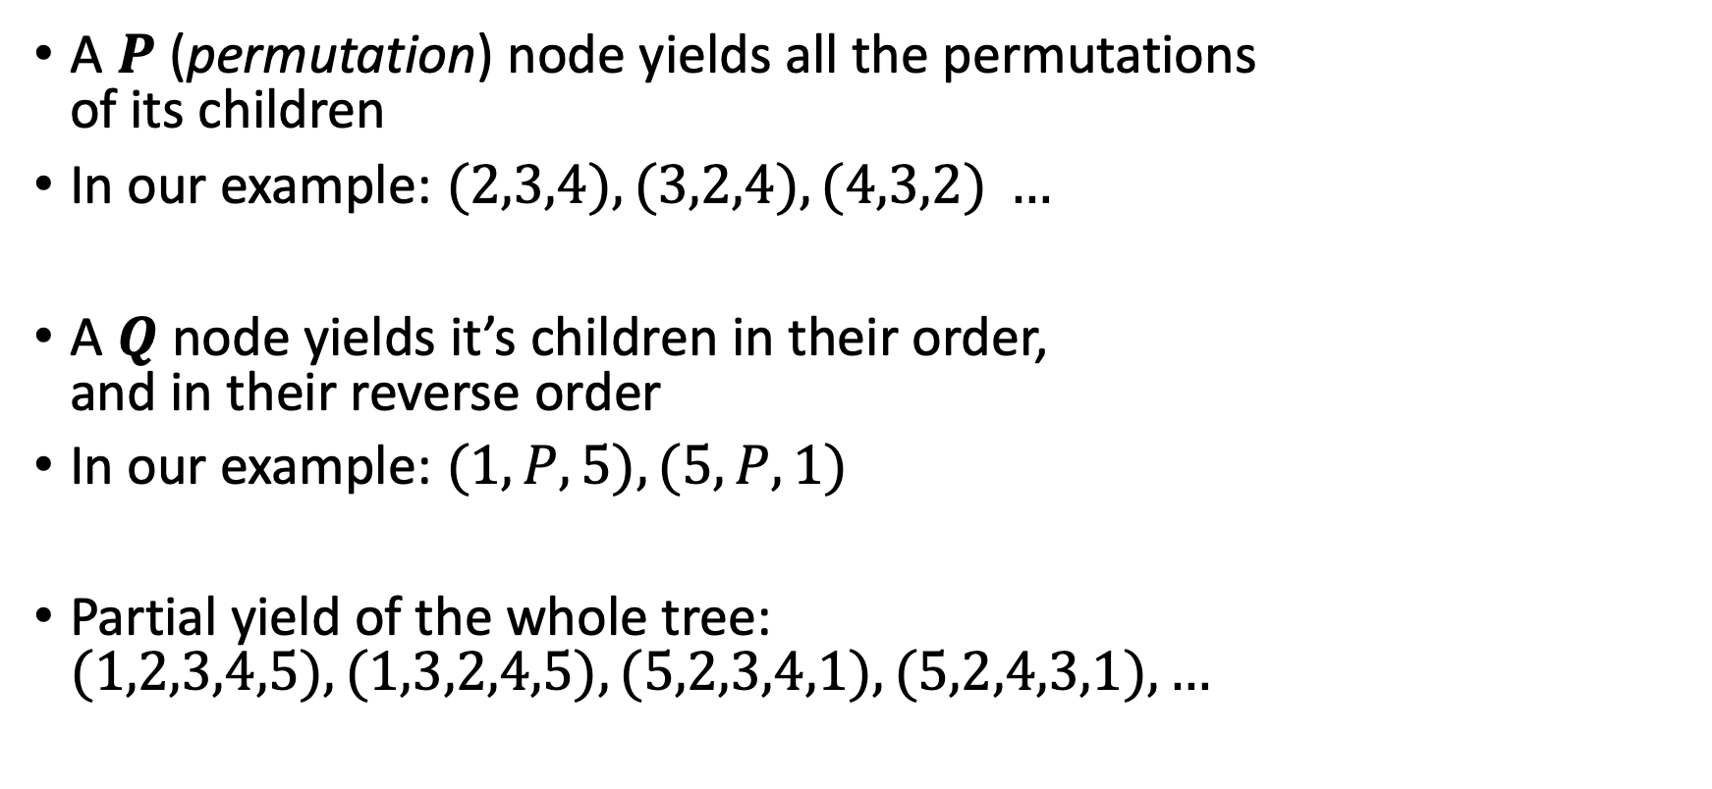
PQTree – Node Yield
A $P$ (permutation) node yields all the permutations of its children
In our example: $(2,3,4), (3,2,4), (4,3,2) …$
A $Q$ node yields it’s children in their order, and in their reverse order
In our example: $(1,P,5), (5,P,1)$
Partial yield of the whole tree: $(1,2,3,4,5), (1,3,2,4,5), (5,2,3,4,1), (5,2,4,3,1), …$

Slide 8
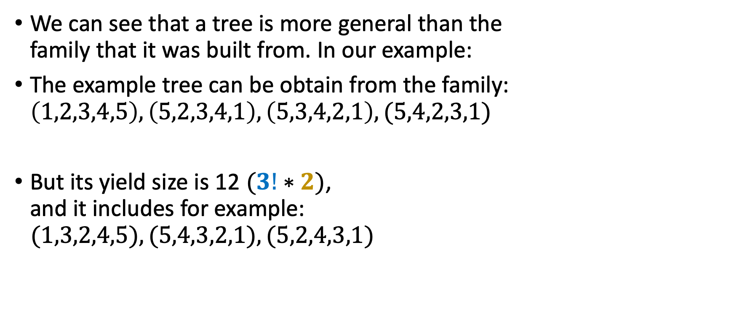
PQTree as a generalizable representation
We can see that a tree is more general than the family that it was built from. In our example:
The example tree can be obtain from the family: $\left(1,2,3,4,5\right), \left(5,2,3,4,1\right), \left(5,3,4,2,1\right), (5,4,2,3,1)$
But its yield size is 12 $(3!∗2)$, and it includes for example:
$$(1,3,2,4,5), (5,4,3,2,1), (5,2,4,3,1)$$

Slide 9
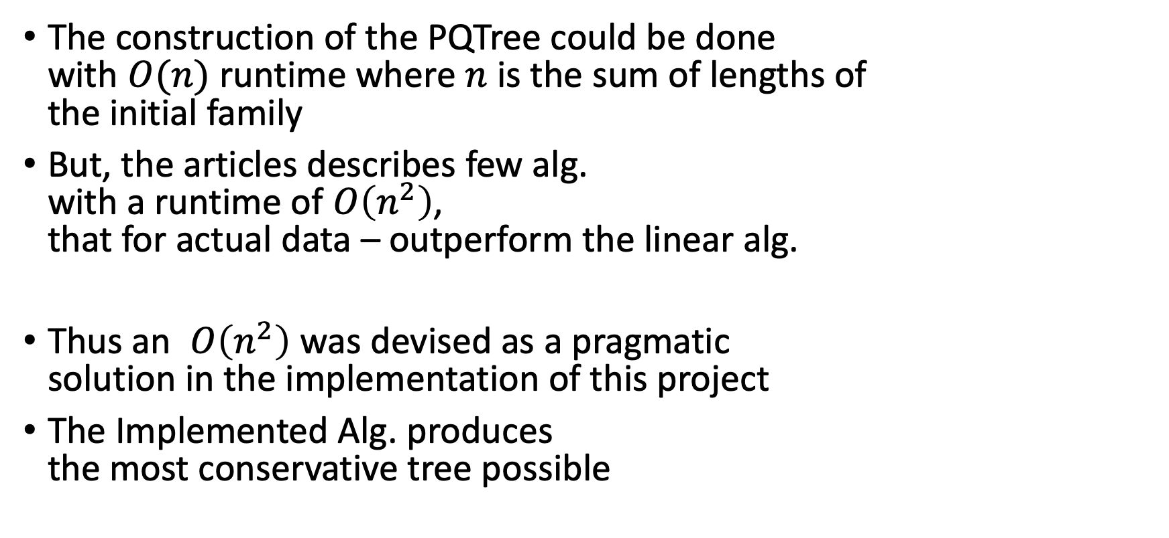
PQTree – Construction
The construction of the PQTree could be done with $O(n)$ runtime where $n$ is the sum of lengths of the initial family
But, the articles describes few alg. with a runtime of $O\left(n^{2}\right)$, that for actual data – outperform the linear alg.
Thus an $O\left(n^{2}\right)$ was devised as a pragmatic solution in the implementation of this project
The Implemented Alg. produces the most conservative tree possible

Slide 10
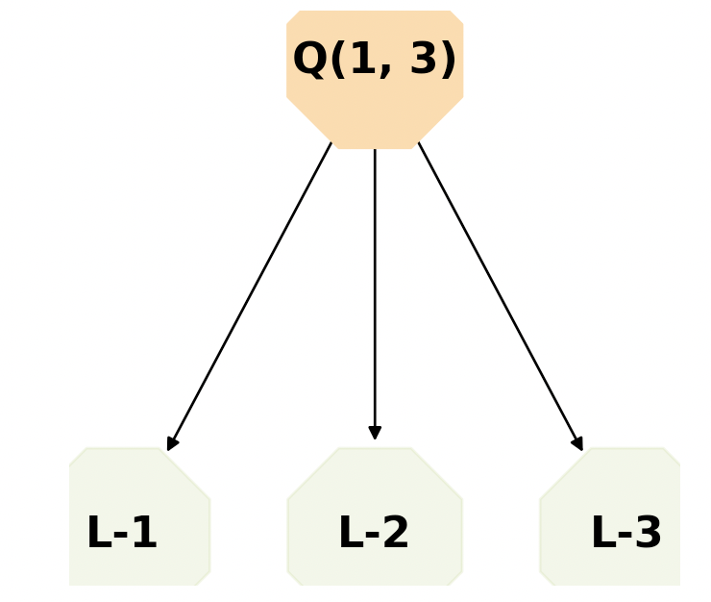
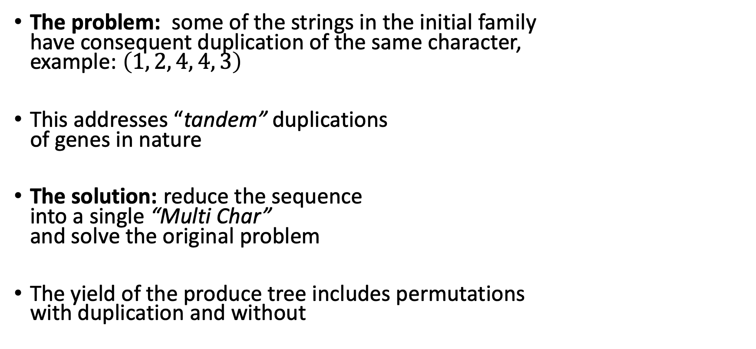
PQTree – Character duplication - sequential
The problem: some of the strings in the initial family have consequent duplication of the same character, example: $\left(1, 2, 4, 4, 3\right)$
This addresses “tandem” duplications of genes in nature
The solution: reduce the sequence into a single “Multi Char” and solve the original problem
The yield of the produce tree includes permutations with duplication and without

Slide 11
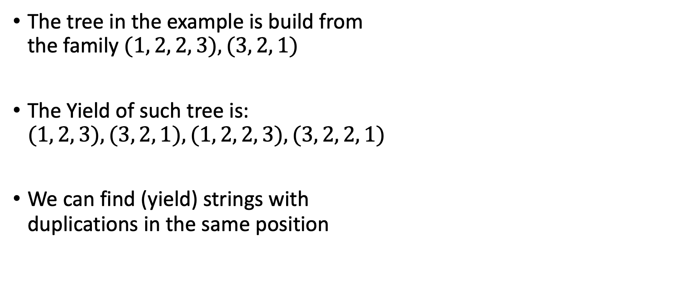
Sequential duplication - example
The tree in the example is build from the family $(1, 2, 2, 3), (3, 2, 1)$
The Yield of such tree is: $(1, 2, 3), (3, 2, 1), (1, 2, 2, 3), (3, 2, 2, 1)$
We can find (yield) strings with duplications in the same position

Slide 12
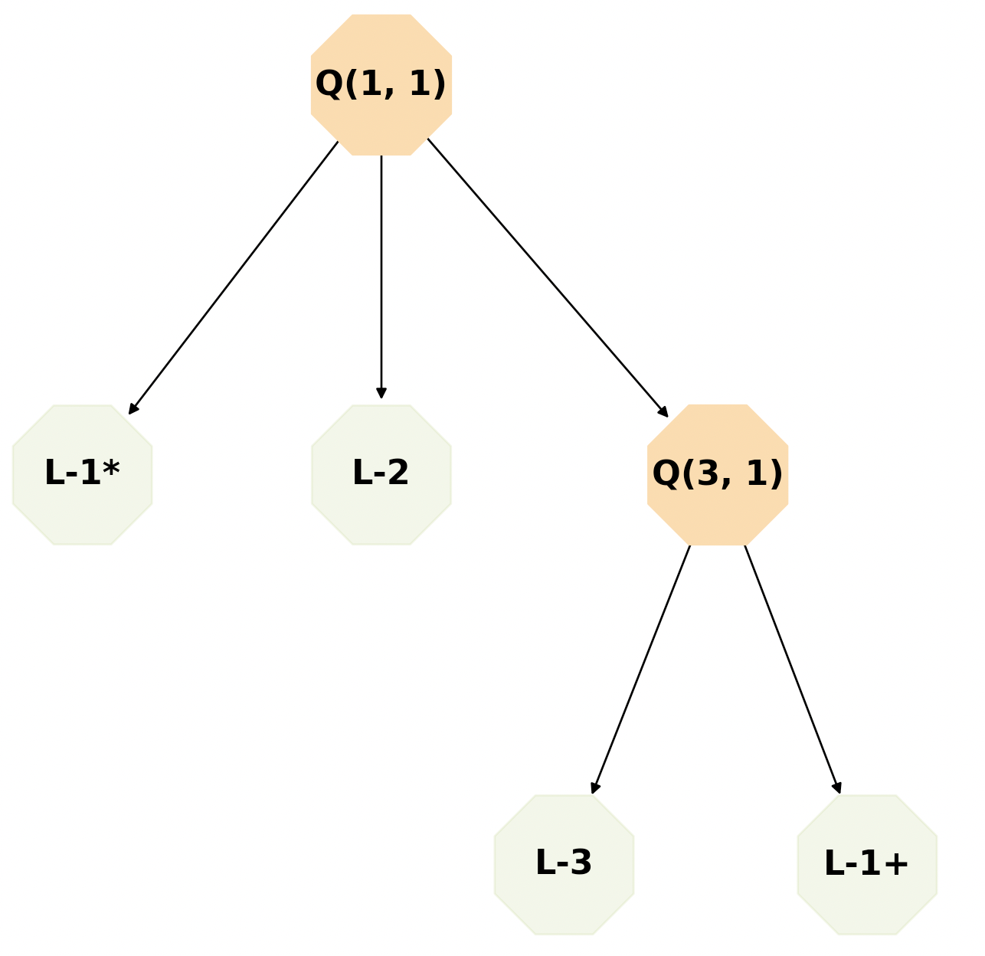
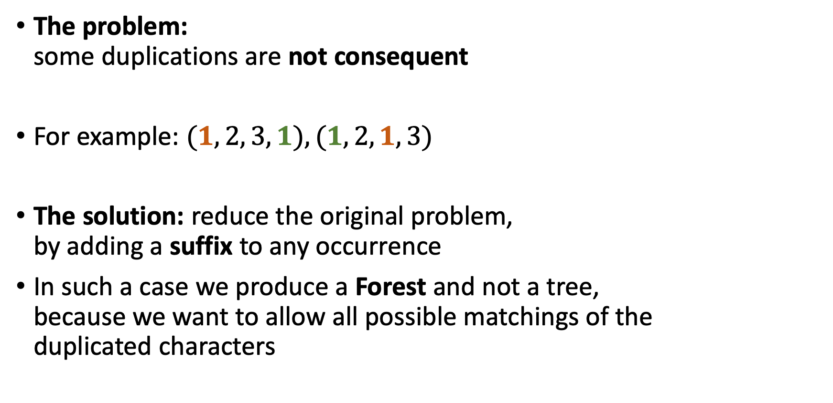
Character duplication - Generalization
The problem: some duplications are not consequent
For example: $(1, 2, 3, 1), (1, 2, 1, 3)$
The solution: reduce the original problem, by adding a suffix to any occurrence
In such a case we produce a Forest and not a tree, because we want to allow all possible matchings of the duplicated characters

Slide 13
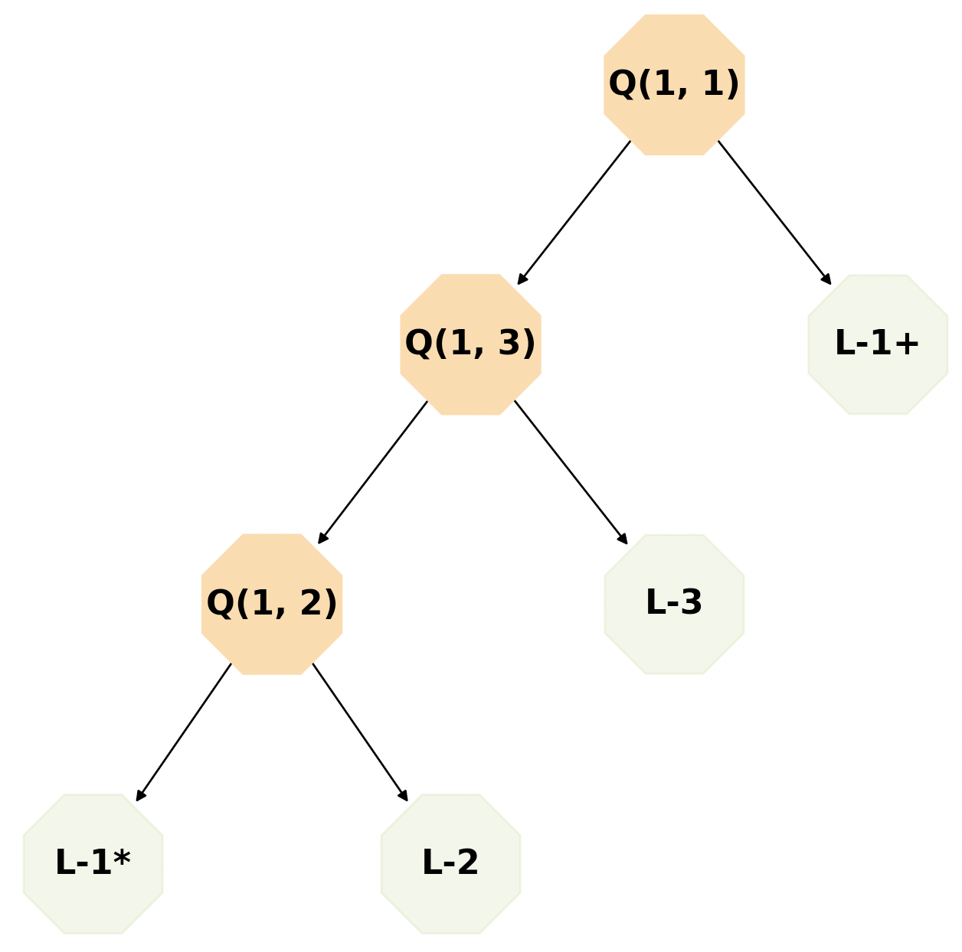
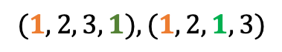
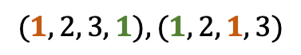
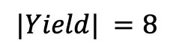
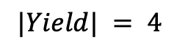
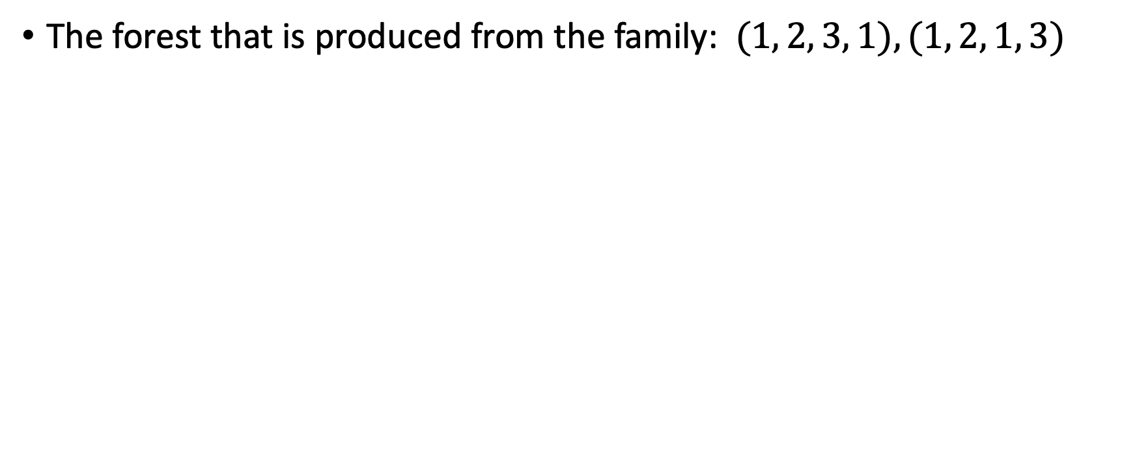
Generalization – Example
The forest that is produced from the family: $(1, 2, 3, 1), (1, 2, 1, 3)$
$$|Yield| =8$$
$$|Yield| = 4$$
$$(1, 2, 3, 1), (1, 2, 1, 3)$$
$$(1, 2, 3, 1), (1, 2, 1, 3)$$
We would prefer using the tree with the smaller yield –
because its more conservative

Slide 14
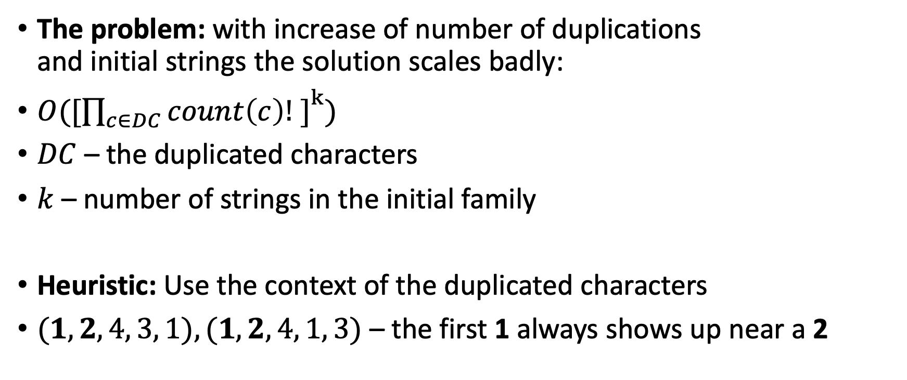
Character duplication – Heuristic
The problem: with increase of number of duplications and initial strings the solution scales badly:
$O([{\prod_{c∈DC}{count\left(c\right)! ]}}^{k})$
$DC$ – the duplicated characters
$k$ – number of strings in the initial family
Heuristic: Use the context of the duplicated characters
$(1, 2, 4, 3, 1), (1, 2, 4, 1, 3)$ – the first 1 always shows up near a 2

Slide 15
Character duplication – Heuristic - Results
The heuristic reduces the complexity of the problem even to a linear problem, when each duplicated character has context
The heuristic performance is at worst case as the original “brute force” solution
From tests done – the heuristic wasn’t able to find the minimal tree for 1/100 of the cases –
From which we conclude that for some cases context of one character is not enough

Slide 16
Main Contribution
Implementation of the PQTree (Python), which could be found at:
https://github.com/levgou/pqtrees
High resolution description of the project:
https://github.com/levgou/pqtrees/blob/master/main.ipynb
“Multi Character” – for consequent char duplications
“PQTree forest” – for the non sequential duplications

